Slide 1
Why Data?
WiMLDS Syracuse Presents Data Basics Training Arc

Slide 2
Agenda
Intros and Warm Up
Why Data?
Areas of Data
Architecture
Modeling
Storage Operations
Resource Management Analytics
Security
Documentation
Data Warehouse/BI
Questions

Slide 3
Intros & Warm Up
One reason you’re passionate about data

Slide 4

Why Data?

Slide 5
Why Data?
Qualitative vs Quantitative
Inherent biases and how data combats that
Using the Null Hypothesis method
Discussion:
What use cases do you see for data in the world?
In what instances could data use prove problematic?
In one sentence how would you communicate the need for data in the world?

Slide 6
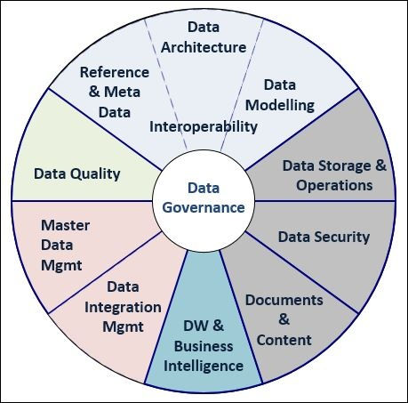
Areas of Data
Data Governance
Holistic structure and implementation of data strategy within an organization
Combination of technology, hardware, and people
Key in creating a comprehensive data solution

Slide 7
Areas of Data
Architecture: Design of the physical and virtual infrastructure by which data is supported.
Modelling: Manipulation of data using algorithms to solve problems.
Storage/Operations: Management of the physical and virtual infrastructure by which data is supported.
Security: Processes, policies, and technology that keeps data safe.
Doco/Content: Documentation saves lives.
DW/BI: Restructuring and analysis of data for decision making.
Integration Mgmt: Design of connection between data sources, esp through data factories.
Quality: Data cleaning. One of the most integral and time consuming steps of data analysis.
Refs/MetaData: Descriptive data associated with each column within a dataset as well as the overall dataset itself

Slide 8
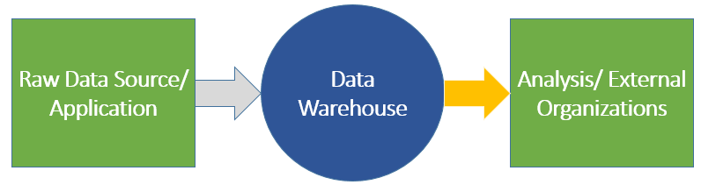
Architecture (Top Layer)
Design, Components, Strategy, and Theory

Slide 9
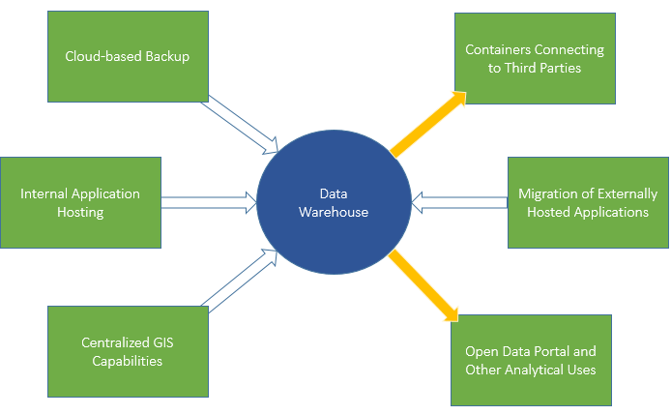
Architecture (Middle Layer)
Design, Components, Strategy, and Theory

Slide 10
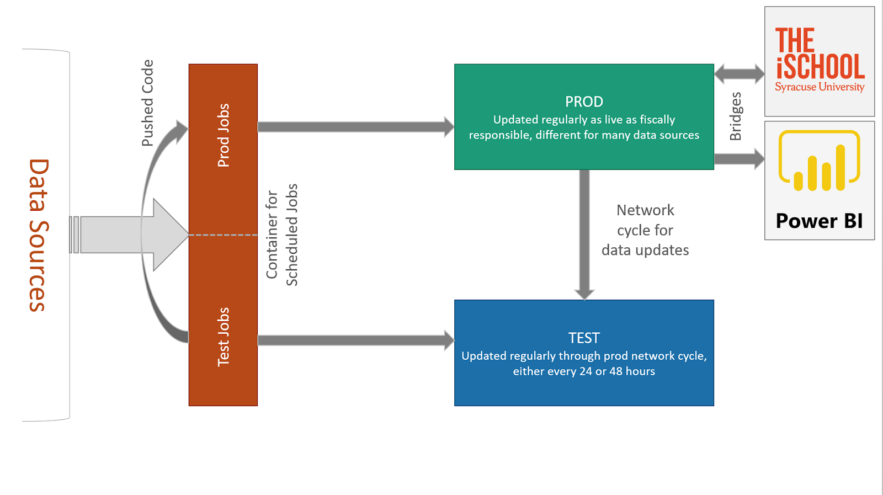
Architecture (Bottom Layer)
Design, Components, Strategy, and Theory

Slide 11
Modeling
Data Infrastructure Mapping: Visual representations of a database or larger server that show the connections between different elements of that data resource. Allows for scalability of data use as more individuals are able to digest the high level layout of the data infrastructure.
Schema Development: Technical and physical layout of tables within a data resource. This is the system by which the actual data will be accessed through querying, and is a key part of the operational functionality of any data resource. Improper schema development or setup has the potential to be detrimental to a data system.

Slide 12
Storage/Operations
Administration: This aspect of data systems tends to be more technical in nature and supports the overall usage of any data resource. Responsibilities include user management, setup of any additional data software and integrations, maintain licenses, identify best practices in implementation, and build out ETL/ELT or Data Factory solutions.
Technical Theory/Layout: Storage and operations involves developing the larger environment that a data resource lives in. Similar to the data architecture, this larger architecture has to be designed and can include firewall, data resources, application containers, bridges to external organizations, ETL/ELT, data factory, code containers, and automation resources in a basic system.
Resource Management: Administration of these environments includes a large amount of resource management. This walks a thin line of spending the least amount possible on hosting costs while ensuring the system is able to run without crashing. There is a significant amount of analytics within this system style itself that support this effort.

Slide 13
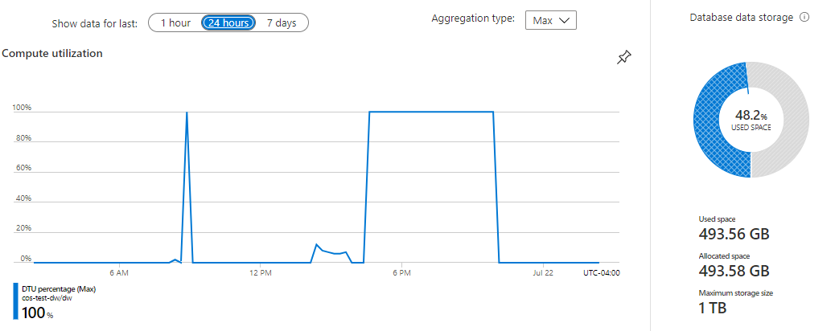
Resource Management Analytics

Slide 14
Security
PII: Personally identifiable information, metrics or combinations of metrics that have the potential to identify a specific person either outright or through descriptive data points within a population. This can be identified in three levels:
Low Risk
Medium Risk
High Risk
Transparency v Security: Historically institutions have gone to great lengths to ensure their data remains extremely private. Within the last five years or so this method has changed and more organizations are offering open data, hackathons, and third party data partnerships. This shift towards transparency has made security even more important as the security has to be fine tuned to continue protecting information required by law or organizational need.
Data Sharing Agreements, NDAs, MOUs: These documents allow different organizations to come together in partnerships or collectives to contribute to the other’s data growth.

Slide 15
Doco/Content
Data Dictionary: A consolidation of all metrics across a data resource with definitions, data type, table location, any notes on the metric, and other information an organization might want to collect on those metrics. The key goals of a data dictionary is to create standardization across a data resource and to provide a single source of definition for users of the system.
Trainings: User training is necessary for any type of data use. Organizations are beginning to hold trainings not only for technical users but for the end users of those reports, dashboards, and other analysis. As a data professional you will need to be able to translate complex data topics to a number of data literacy levels.
Workshops: Unlike trainings, workshops are much more hands on and meant to engage those within the session. These are used to help develop use cases, identify gaps in knowledge, break down silos, build data strategy, and answer other larger data related questions.

Slide 16
Data Warehouse/Business Intelligence
Consolidation of Data: DW is meant to bring data from different resources into a single database for cross-departmental and higher level analytics.
Scalability: DW requires an organization to critically look at their data governance, stewardship, and processes during development ensuring an environment that can be scalable.
Types of Data Warehouse Schema:
Star: All dimension tables relate back directly and only to the fact table
Snowflake: Dimension tables and fact tables interconnect, often with multiple fact tables in a single schema
Galaxy: Multiple fact tables connect to each other across the dimension tables. Dimension tables do not connect to one another
Algorithms/Operations/Predictive: This type of BI relies on back end development to support processes and are often not intrinsically seen by the end user.
Dashboarding & Reporting: Visualizations and reports are the most referenced form of BI. These allow for self serve analytics further down the data literacy chain.

Slide 17

Questions

